Slide 1
Risk Register
GRC – Cyber Security
V1.0 16th May 2025

Slide 2
Why a Risk Register
Definition of a Risk Register:
A structured document used by an organization to pro-actively manage risk.
Purpose of a Risk Register:
A centralized mechanism for recording, tracking and reporting of identified risks, their potential likelihood, potential impact, inherent risk, treatment and residual risk.

Slide 3

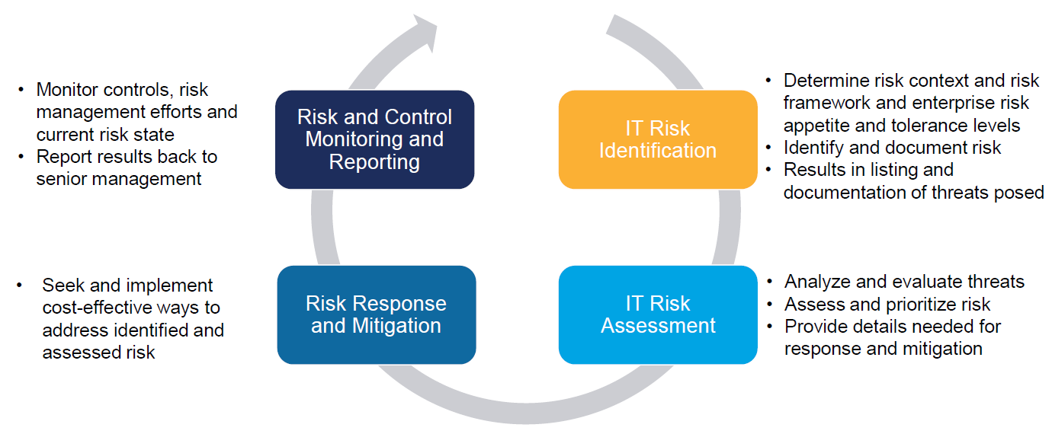
Risk Management Lifecycle
Risk Management Lifecycle

Slide 4
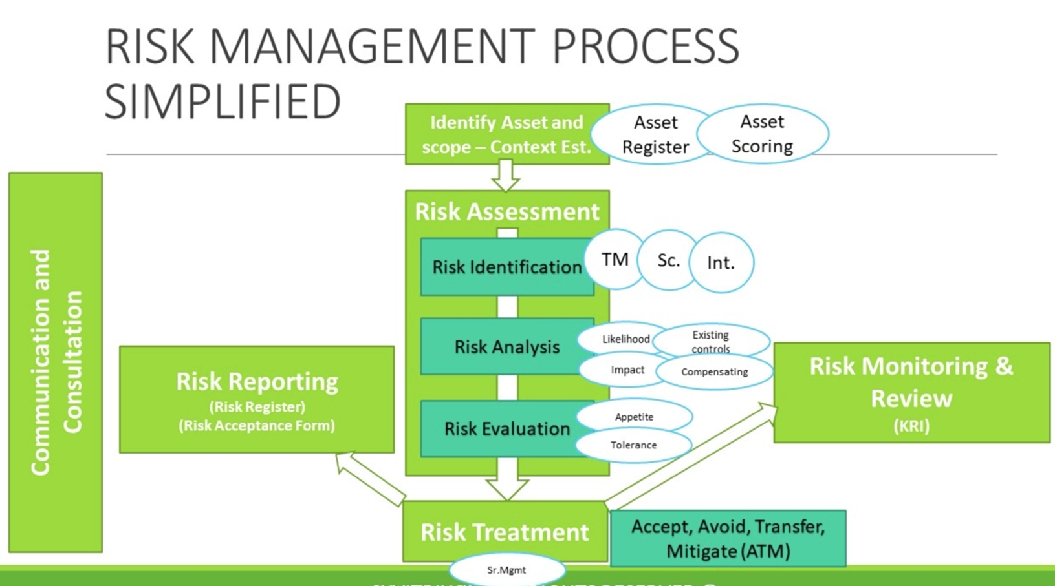

Slide 5
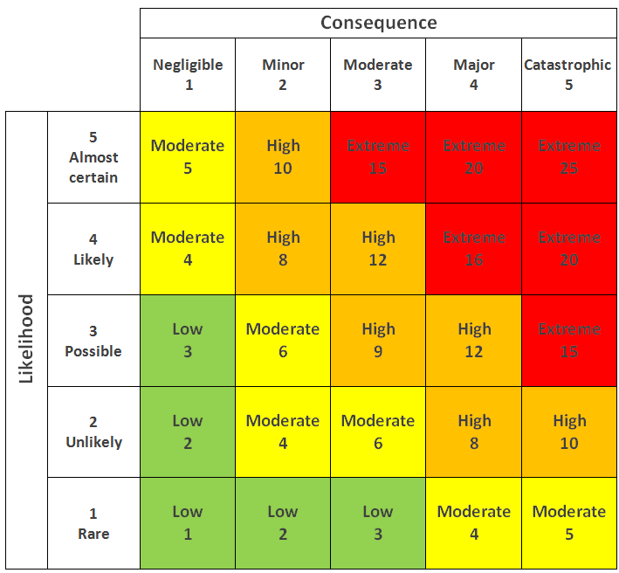
Risk Matrix
Qualitative Risk Matrix (subjective approach)
Risk = Likelihood x Consequence
Risk = Intersect Point (either numerical value or Low / Moderate / High / Extreme)
Note: This is a risk matrix for an ERM..Given that the Consequence for Redback Operations is unlikely to be anything but “Negligible”, the risk will not exceed “Moderate” (unless of course PII is being handled)

Slide 6
Inherent Risk vs Residual Risk
Inherent Risk:
Inherent risk refers to the natural risk level in a process that has not been controlled or mitigated
Residual Risk:
Residual risk is the remaining risk after risk mitigation measures (such as controls) have been implemented.

Slide 7
Risk Categories
Operational
Compliance
Internal
Third party
Strategic
Reputational

Slide 8
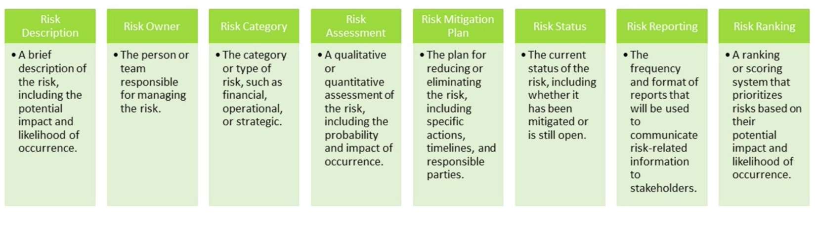
Suggested Risk Register Contents
Cyvitrix -2025

Slide 9
Sample Risk Register

Slide 10

Any Questions?
GRC Team – Cyber Security

Slide 11
Thank You ☺
GRC Team – Cyber Security

